Slide 1
Logic Gates
Boolean algebra is used to model the circuitry of electronic devices
Each input and each output
of such a device can be thought of as a member of the set {0, 1}.
A computer, or other electronic
device, is made up of a number of circuits.
Each circuit can be designed using the rules of
Boolean algebra

Slide 2
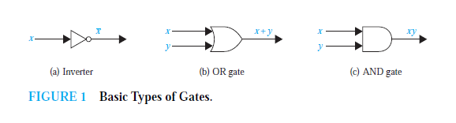

Slide 3
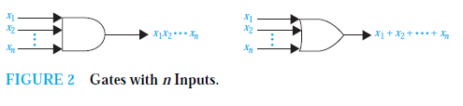

Slide 4
Combinations of Gates
Combinational circuits can be constructed using a combination of inverters, OR gates, and AND
gates.
Figure 3 illustrates the two ways of showing gates with the same input values.
Note also that output from a gate may be used as input by one or more other elements, as shown in Figure 3.
Both drawings in Figure 3 depict the circuit that produces the output

Slide 5
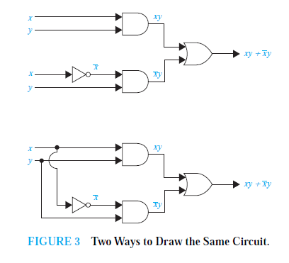

Slide 6
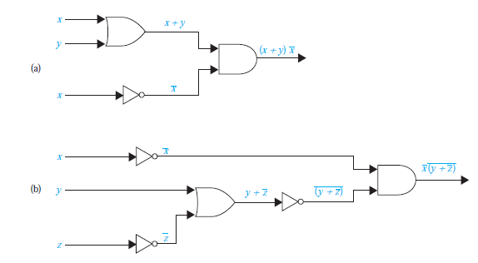

Slide 7
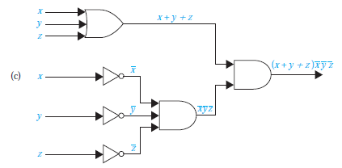
Which is the required Circuits that Produce the Outputs Specified

Slide 8
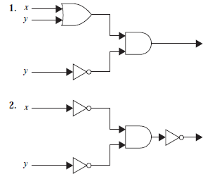
Find the output of each of these combinatorial circuits.

Slide 9
